Slide 1

Forensic DNA Testing

Slide 2
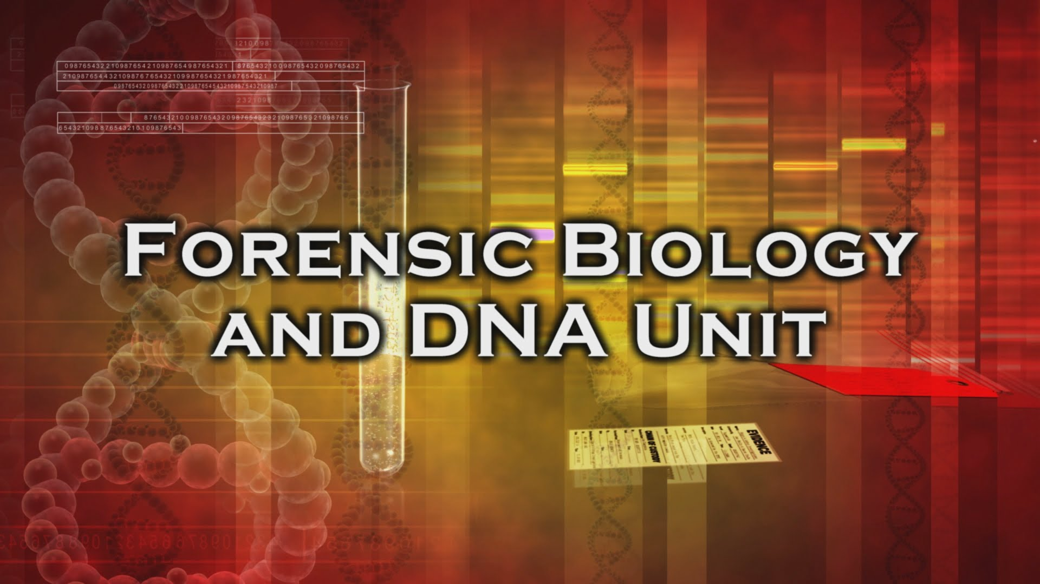
Notes:
https://www.youtube.com/watch?v=kF6EGa8GpD0&list=PL4CMHuzSfzs7WV6ivV6iV4R6mT-YnqJ8G&index=3

Slide 3
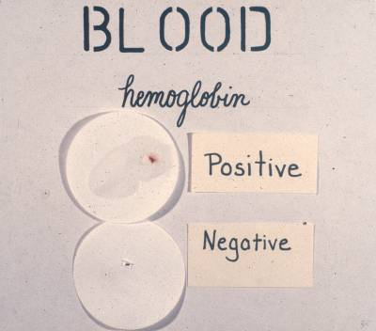
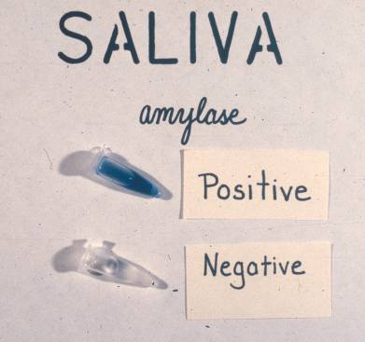
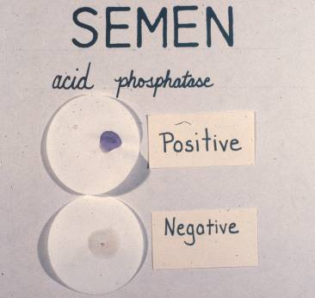
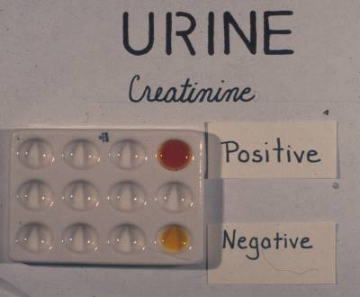
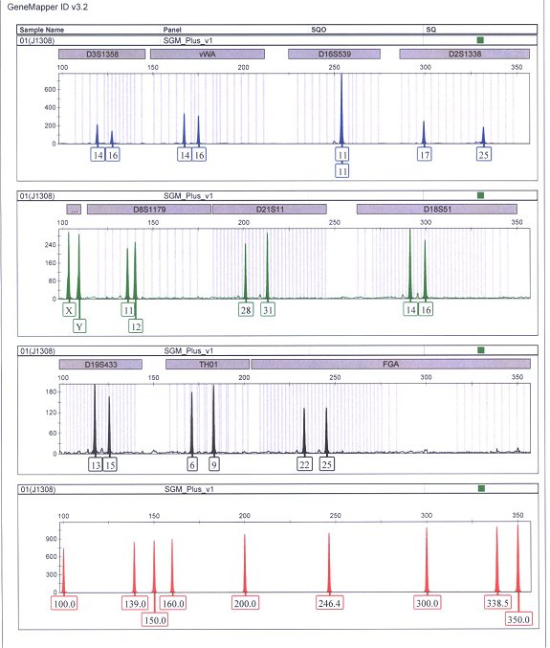
DNA Section Units
Casework
  Serology and/or DNA testing on investigative and trial casework
Database
  Collects and processes DNA samples collected from arrestees & convicted offenders
Technical
  Research, validation, training, QA/QC

Slide 4
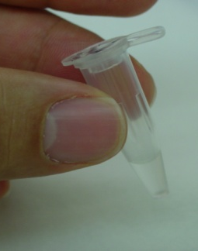
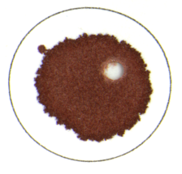
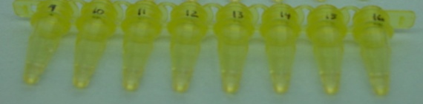

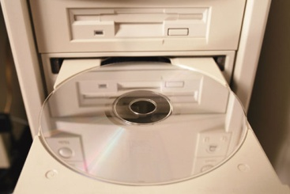
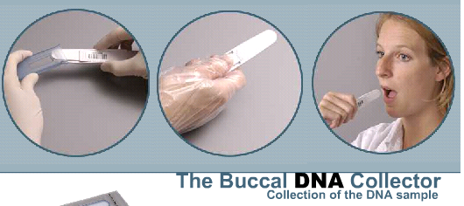
Steps in Forensic DNA Analysis
Steps Involved
Usually 1-2 day process (a minimum of ~5 hours)
Collection
Slot Blot
1 ng
Serology
0.3 ng
No DNA
0.5 ng
0.5 ng
Extraction
0.7 ng
Blood Stain
Buccal swab
1 ng
1. Sample Collection & Storage
2. DNA Extraction
1 ng
Quantitation
3. DNA Quantitation
Biology
Multiplex PCR
STR Typing
If a match occurs, comparison of DNA profile to population allele frequencies to generate a case report with probability of a random match to an unrelated individual
Genetics
4. Multiplex PCR Amplification
Interpretation of Results
DNA separation and sizing
Database Storage & Searching
7. DNA Database Search
Technology
5. STR Typing
Calculation of Match Probability
Male: 13,14-15,16-12,13-10,13-15,16
6. Interpretation of Results

Slide 5
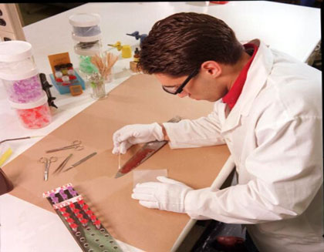
Forensic Serology
Serology: the identification of bodily fluids
  Blood
  Saliva
  Urine
  Feces
  Etc.
Done prior to DNA testing

Slide 6
Biology/DNA
EVIDENCE
SUSPECT
The profiles MATCH!

Slide 7

Questions?

Slide 8
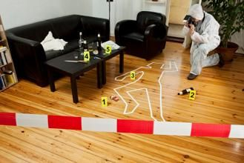
Homicide Case
At approximately 11:51 pm, a 911 call was made regarding a homicide at an apartment home.
The Crime Scene Team immediately reported to the scene.
There is evidence that there was potentially a struggle between the victim and suspect. The suspect may have been injured during the altercation.
Notes:
8

Slide 9
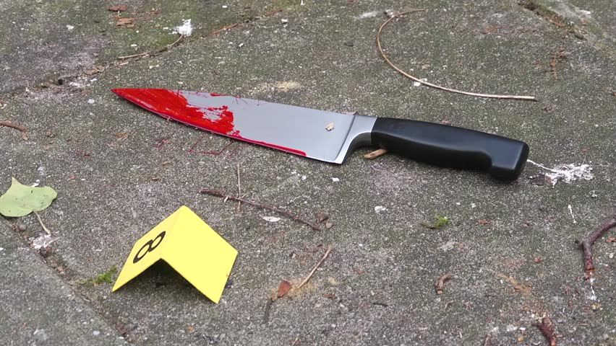
The Evidence
The Crime Scene Team identified a knife with reddish-brown stains on the blade.
Before submitting the item to your laboratory they first swabbed the handle for touch.
Solve the Case!
Split up into groups
Test the evidence for blood
If positive, “send to DNA”.
Interpret DNA results.
Notes:
9

Slide 10
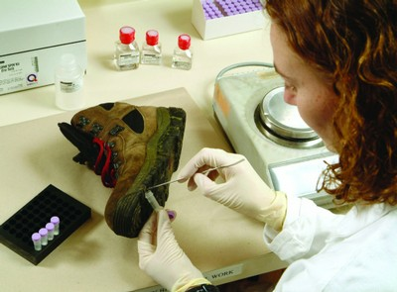
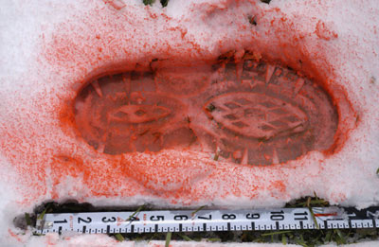
About the Kastle Meyer (Phenolphthalein) Test
Presumptive Test for Blood
  A DNA profile can be generated from blood
3 Steps
  Step 1: Alcohol
  Step 2: Kastle Meyer Reagent
  Step 3: Hydrogen Peroxide
POSITIVE: Turns pink
  Sent to DNA
NEGATIVE: No color change
  No further analysis
Notes:
10

Slide 11
Phenolphthalein (Kastle-Mayer) Test
The peroxidase activity of heme groups in blood catalyzes the oxidation of reduced and colorless phenolphthalin to phenolphthalein
Notes:
The phenolphthalein is boiled to remove the oxygen and it becomes colorless.
Once it is oxidized, it turns pink again.
The alcohol increases the sensitivity of the test by ‘cleaning up’ the area in and around the bloodstain to better expose the hemoglobin.

Slide 12
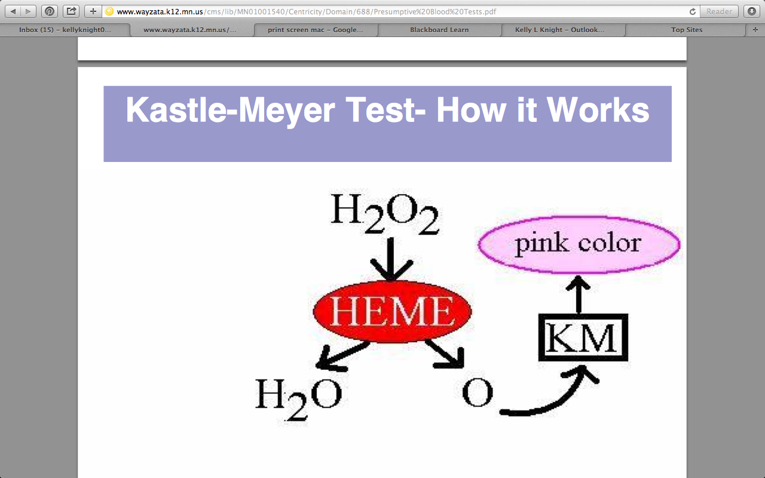
Notes:
When you add hydrogen peroxide, the heme in our blood breaks the H2O2 into water and an oxygen free radical.
It can do this because it acts like a peroxidase.
KM is oxygen starved (boiled oxygen out) so the oxygen radical oxidizes the KM and turns it pink.

Slide 13
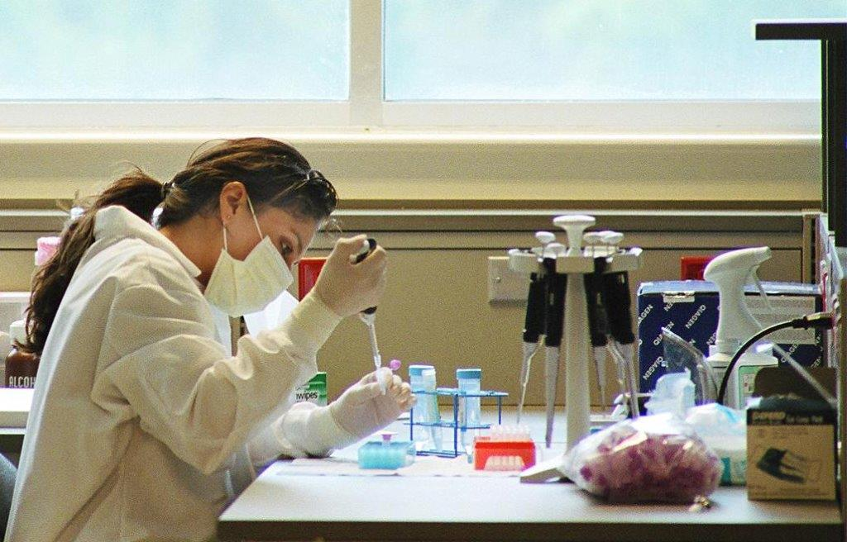
Analyzing the Case
Wear proper PPE
Clean your utensils and work area
Test your controls
  Purpose of controls
Record notes
Test evidence items
  Rub swab on filter paper
    Or moisten swab with H2O to collect stain
  Add reagents
  Record results
    Pink= Positive
    No color change= Negative
Notes:
13

Slide 14
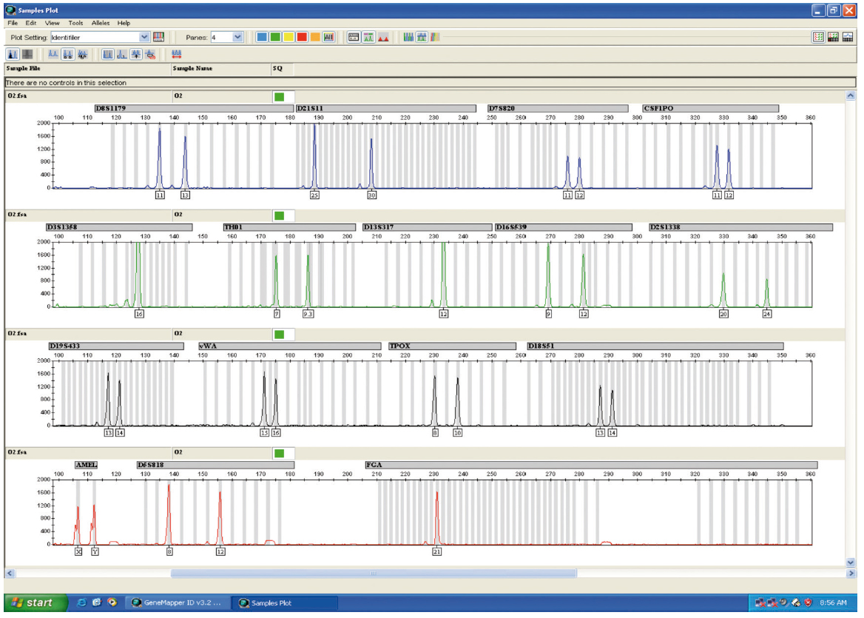
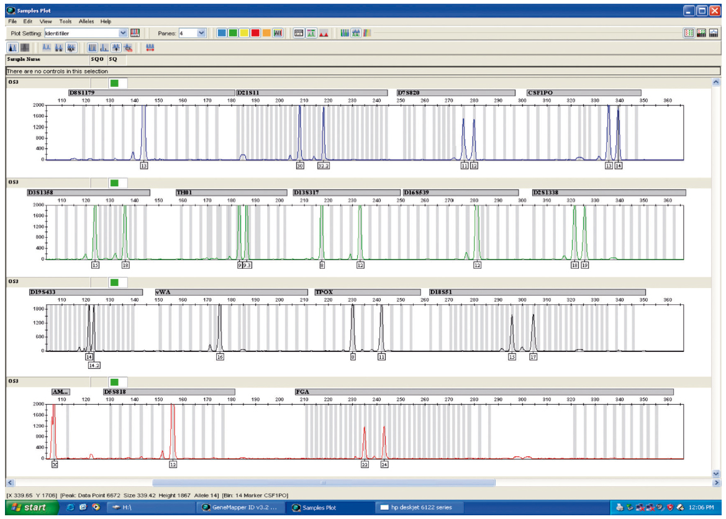
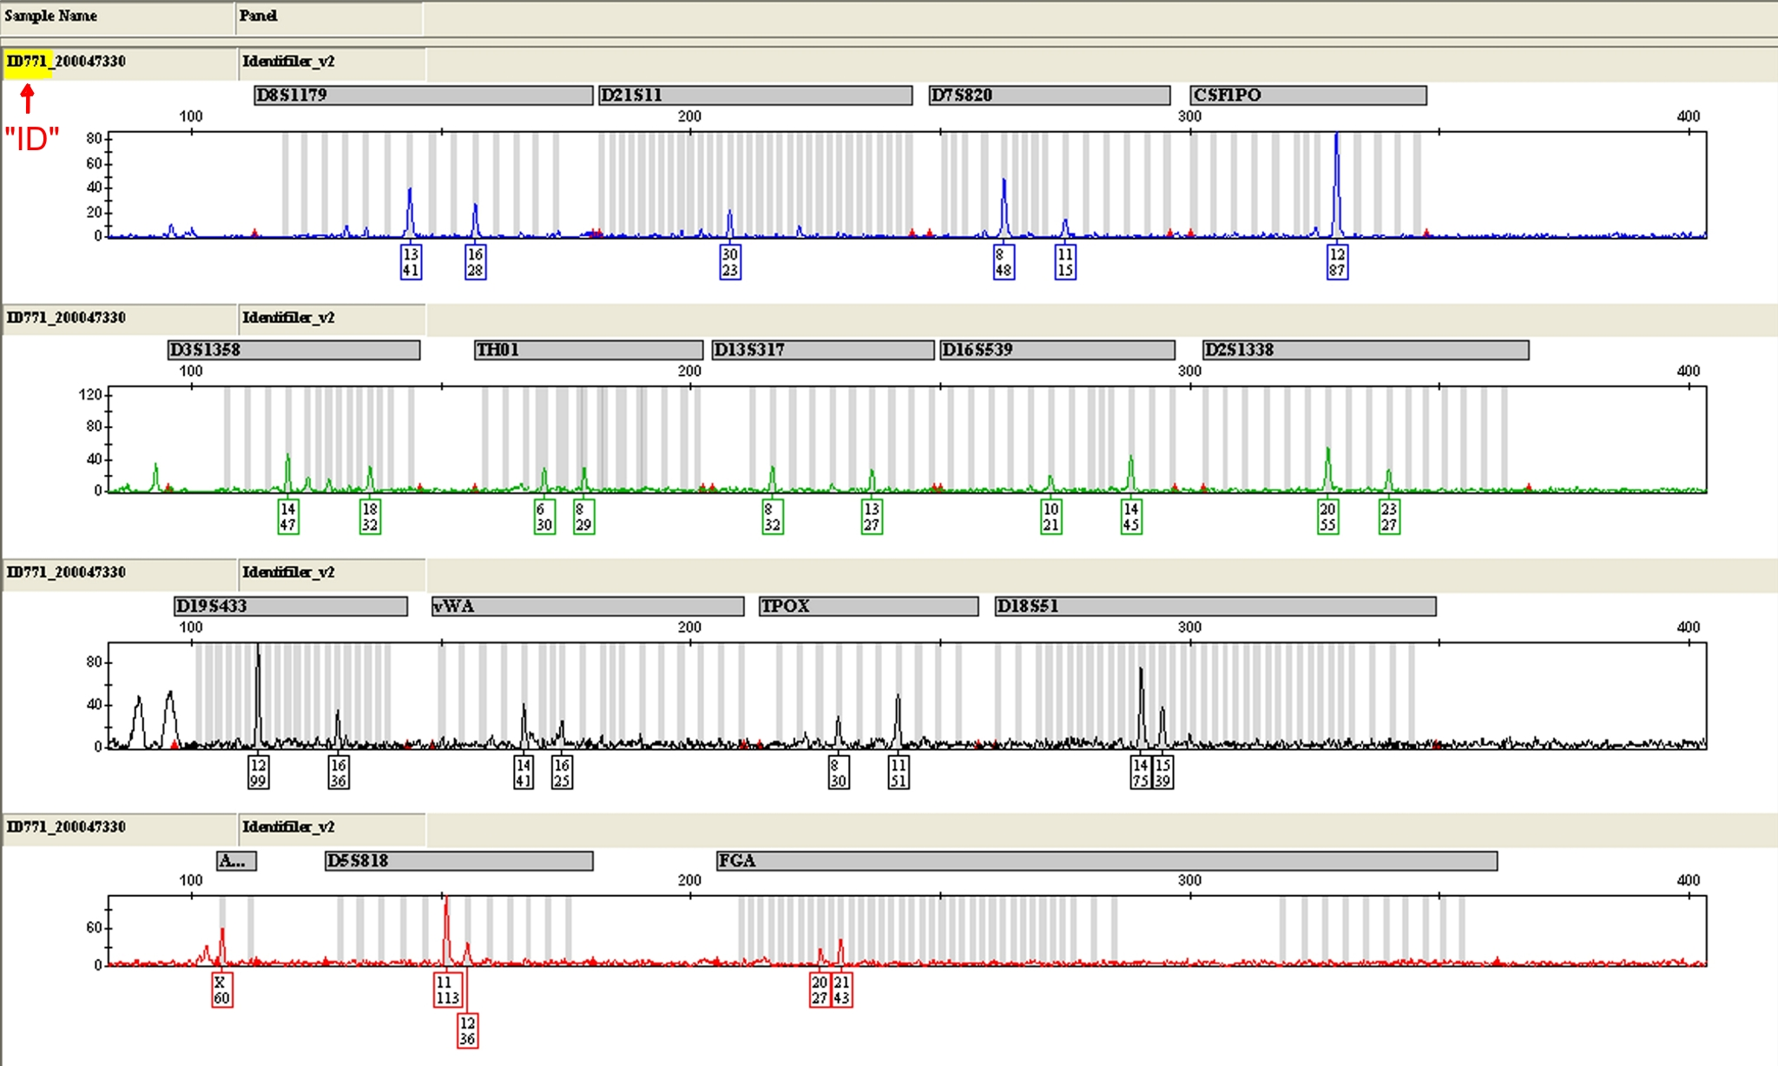
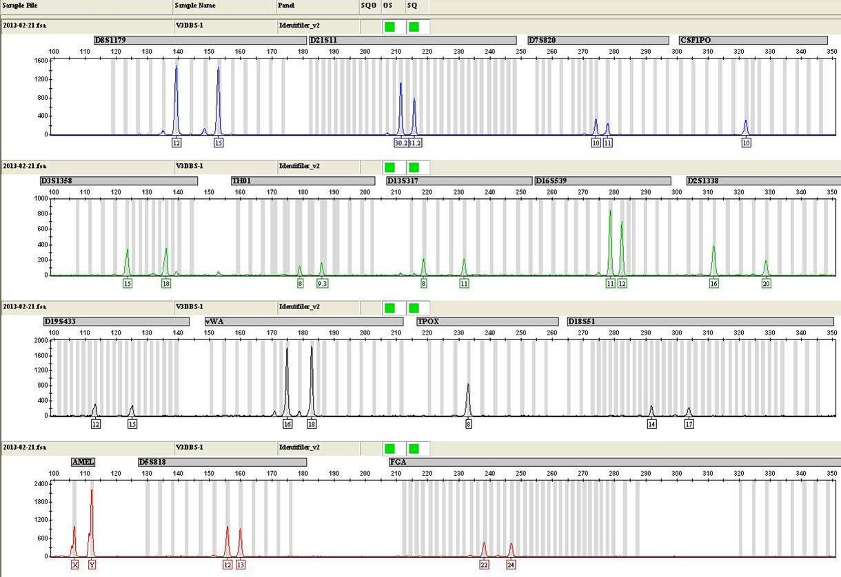
Example: DNA Results
EVIDENCE PROFILE:
KNOWN REFERENCE PROFILES
VICTIM KNOWN PROFILE:
SUSPECT 1 KNOWN PROFILE:
SUSPECT 2 KNOWN PROFILE:
SUSPECT 3 KNOWN PROFILE:

Slide 15
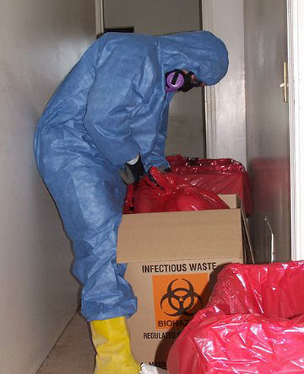
Report
What were your group’s results for the evidence items???
Which items could be tested for DNA??
What were the DNA results?
Notes:
15

