Slide 1
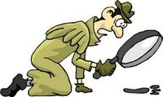
Forensic DNA

Slide 2
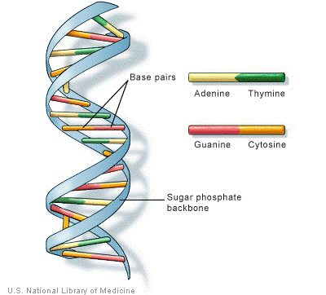
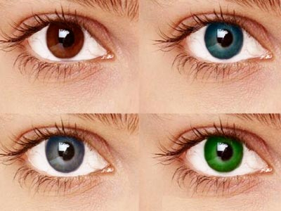
Forensic Biology
What is DNA?
Holds the code for every cell in your body
Like an instruction manual

Slide 3

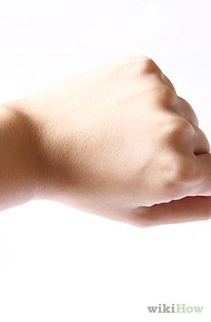
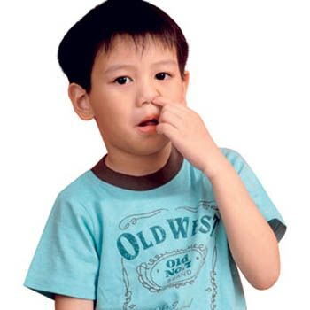

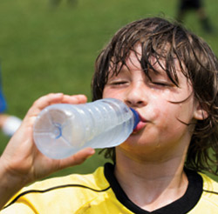
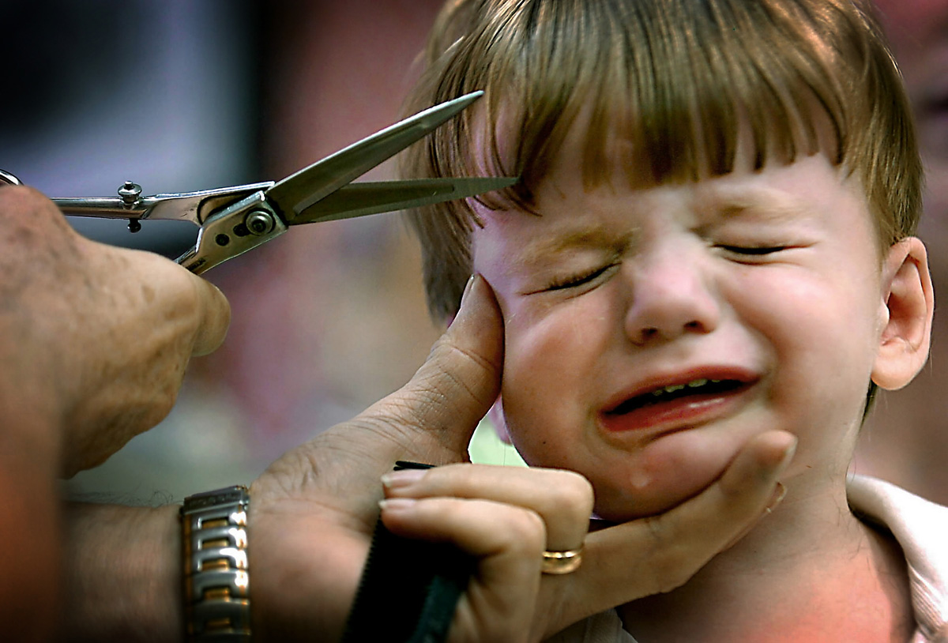
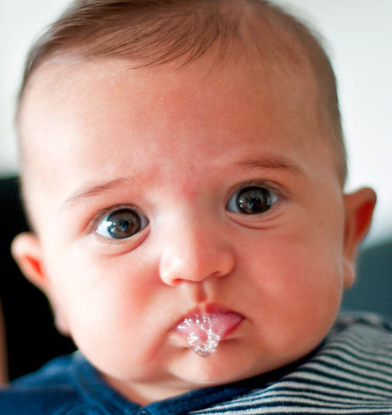
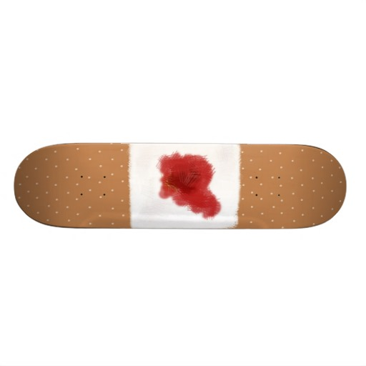
Where can we find DNA?

Slide 4
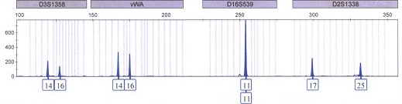
Biology/DNA
EVIDENCE
SUSPECT
The profiles MATCH!

Slide 5
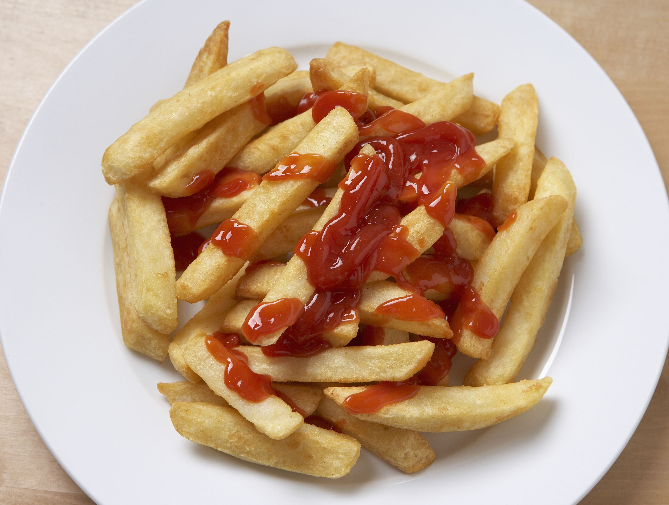
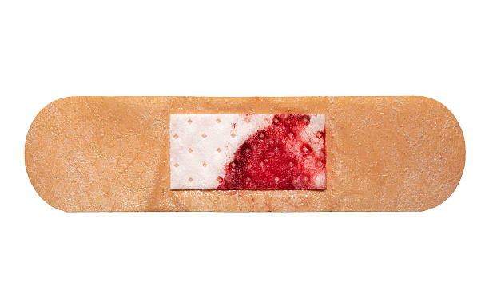
Serology & DNA
Serology: the identification of bodily fluids
Helps us answer questions like:
Is it ketchup or blood?

Slide 6
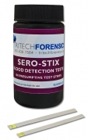
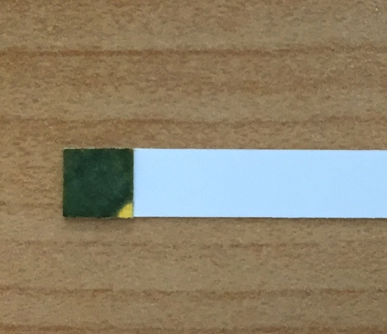
Blood testing-Sero-Stix
Fast & easyway to test for blood
Procedure:
Moisten swab with water
Swab suspected stain
Press stained swab to test patch for a few seconds
Positive=Green to deep blue color

Slide 7
Police Report: At approximately 0900 hours, the Suspect entered classroom and burglarized locker of Victim. Suspect proceeded to eat Victim’s lunch and fled scene upon entry of Janitor. Process crime scene for potential items containing DNA evidence.

Slide 8

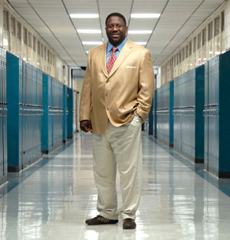

The Suspects
Suspect
2
Suspect
1
Suspect
3

Slide 9
Test The Evidence
Brown paper bag
Bandaid

Slide 10
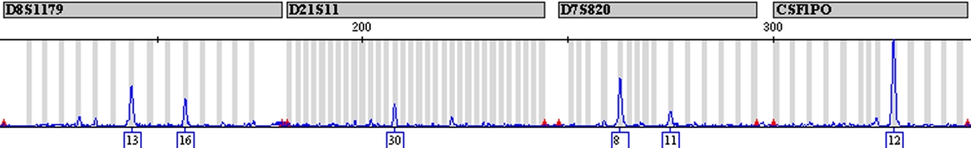
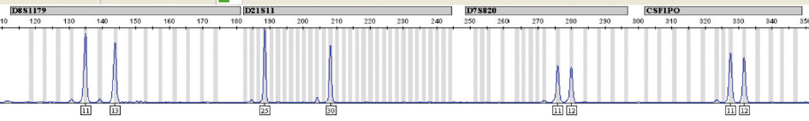
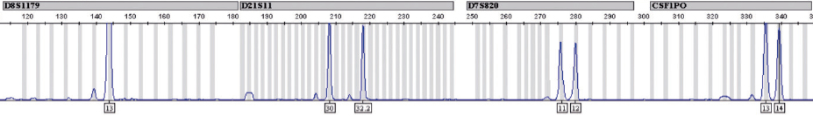
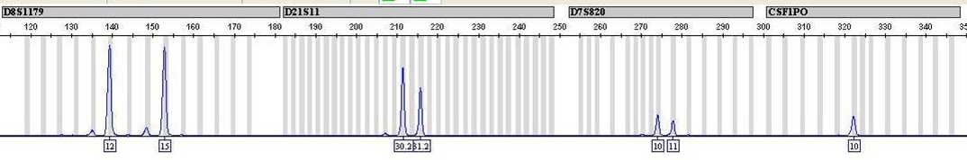
DNA Results from Bag
EVIDENCE PROFILE:
KNOWN REFERENCE PROFILES
VICTIM KNOWN PROFILE:
SUSPECT 1 KNOWN PROFILE:
SUSPECT 2 KNOWN PROFILE:
SUSPECT 3 KNOWN PROFILE:

Slide 11
DNA Results from Bandaid
EVIDENCE PROFILE:
KNOWN REFERENCE PROFILES
VICTIM KNOWN PROFILE:
SUSPECT 1 KNOWN PROFILE:
SUSPECT 2 KNOWN PROFILE:
SUSPECT 3 KNOWN PROFILE:

Slide 12

Conclusions
What do we know from the evidence?
Who stole the lunch?

Slide 13
Did you pick the right suspect?
GUILTY!!!!

Slide 14
Optional Way to Show DNA Results
Evidence | Evidence Profile | Suspect | Suspect Profile
Drink | 9, 10 | 1: | 4, 5
Snack | 9, 10 | 2: | 9, 10
Hat | 9, 10 | 3: | 7, 8
Bandaid | 7, 8
Chewing Gum | 4, 5

