Slide 1
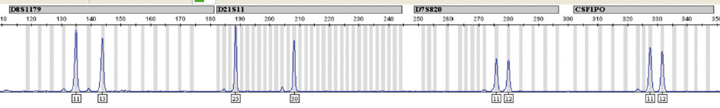
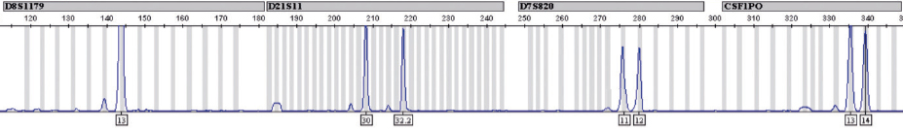
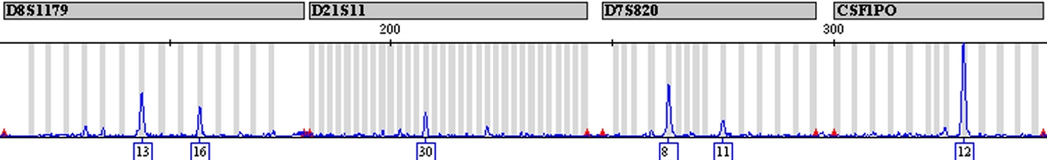
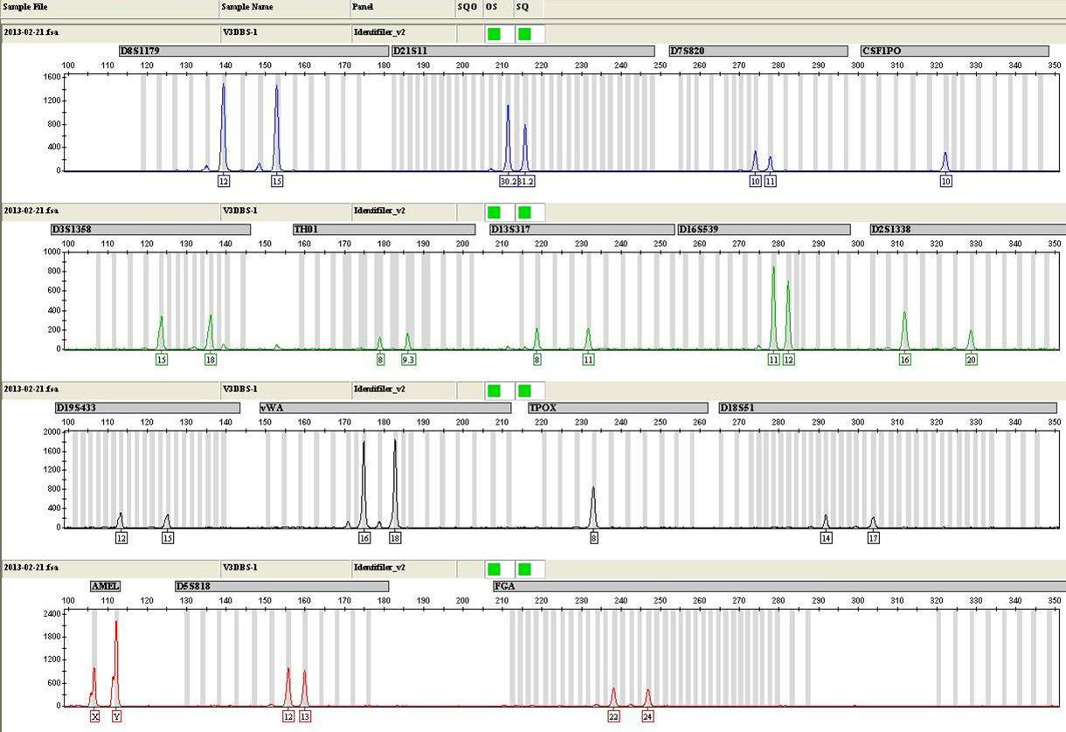
DNA Results from Knife Blade
EVIDENCE PROFILE:
KNOWN REFERENCE PROFILES
VICTIM KNOWN PROFILE:
SUSPECT 1 KNOWN PROFILE:
SUSPECT 2 KNOWN PROFILE:
SUSPECT 3 KNOWN PROFILE:

Slide 2
DNA Results from Knife Handle
EVIDENCE PROFILE:
KNOWN REFERENCE PROFILES
VICTIM KNOWN PROFILE:
SUSPECT 1 KNOWN PROFILE:
SUSPECT 2 KNOWN PROFILE:
SUSPECT 3 KNOWN PROFILE:

